Slide 1
Deep Learning Based Medical Image Super Resolution and Disease Detection
Supervisors - Dr. Bakul Gohel and Dr. Harkeerat Kaur
Author - Mayank Sharma

Slide 2
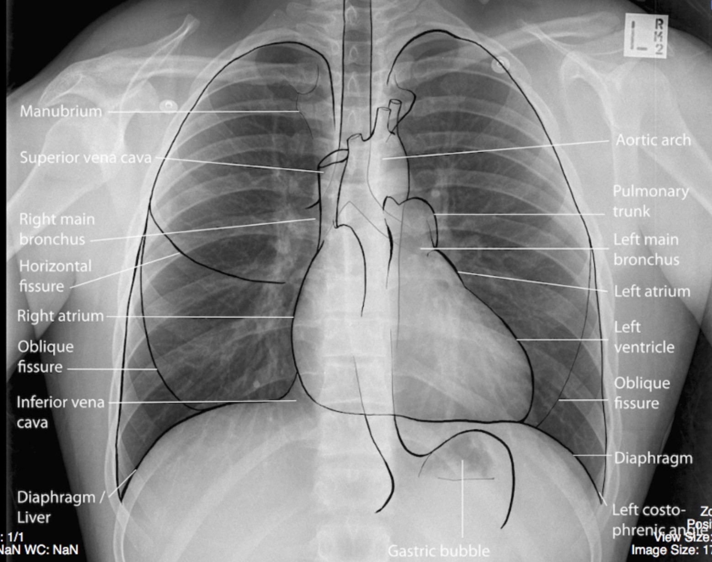
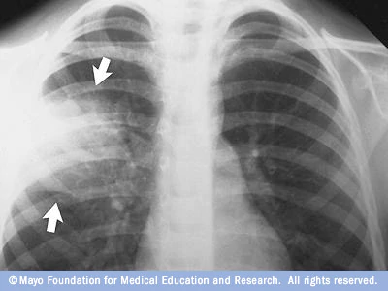
Normal VS Abnormal Medical Image
source - Normal, Labelled, Chest x-ray – Undergraduate Diagnostic Imaging Fundamentals (pressbooks.com)
source - Chest X-ray showing pneumonia - Mayo Clinic

Slide 3
PROBLEM STATEMENT
PROBLEM STATEMENT 1
Validating existing image super resolution techniques over medical images.
Observe the impact, specifically on the abnormality region in the image.
Change in the appearance (i.e - texture, brightness etc) of abnormality due to super resolution might lead to wrong interpretation by the radiologists.

Slide 4
PROBLEM STATEMENT
PROBLEM STATEMENT 2
Create models for different medical image modalities (ie. CT, MRI, X-Ray, Ultrasound etc.).
At present we have many deep learning based models for classifying specific to disease type or tumor type.
Example 1 - A model specifically designed for classification of glioma, meningioma, and pituitary tumors.
Example 2 - A model specifically designed for classification of High grade Glioma (HGG) and Low Grade Glioma (LGG)

Slide 5
PROBLEM STATEMENT
PROBLEM STATEMENT 2
We aim to create a model which highly capable to identify normal image in a modality.
Alternate interpretation can be, a model capable enough to distinguish the abnormal image (What kind of abnormality you ask? Our model does not answer, this decision is in the hands of radiologist )
Hence we are creating a model for one class classification problem.

Slide 6
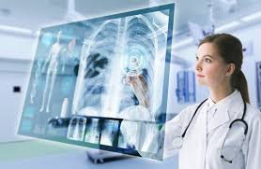
MOTIVATION
Super Resolution plays a key role in medical imaging. Based on the statistics, it is found that on an average a radiologist, working 8 hours, reads 100 images which eventually leads to burnout. A high resolution image will not only reduce radiologists time but will also improve the decision accuracy.
Source - The Takeoff of the IoT in Radiology | Imaging Technology News (google.com)

Slide 7
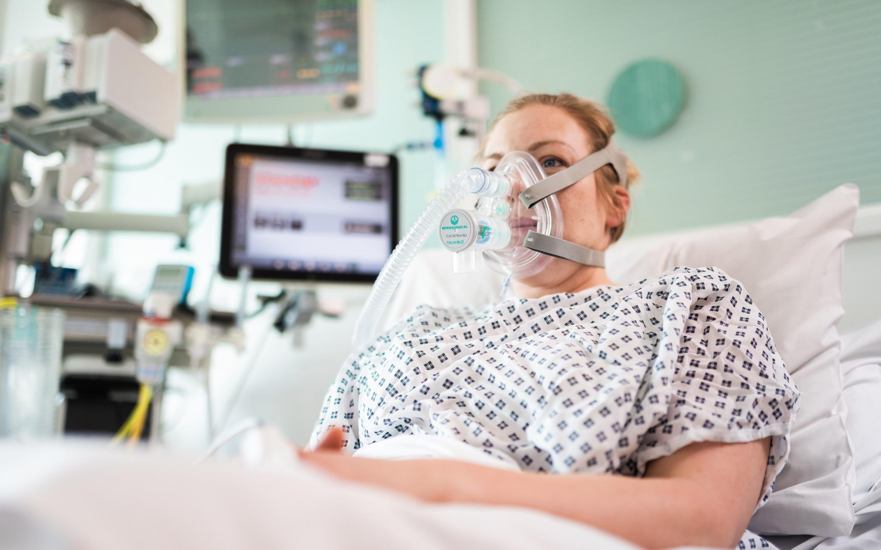
MOTIVATION
A very good model capable of distinguishing normal images can be deployed in emergency workflow, where this model can be used to prioritize images to read which can be life saving.
source - UCL, UCLH and Formula One develop life-saving breathing aids for the NHS | UCL News - UCL – University College London (google.com)

Slide 8
MOTIVATION
Decrease Radiologists Workload/Pressure
Suppose, if on an average a radiologist takes about 5 min to read a X-Ray image. Say we have 20 images I1, I2, I3….I20. Now, say images I5,I9 and I12 require urgent reading. Images come to radiologist in queue order, means important images will be read after 20 min, 40 min and 55 min respectively. Which is not desirable. If we can somehow identify normal cases, then we can prioritise and move important images to top (i.e I5, I9, and I12) which will they be read immediately by the radiologist and normal cases can be read later on.

Slide 9
LITERATURE REVIEW
Existing super resolution techniques are proposed only on normal images. Even if they are efficient, if they create any change in abnormality in an abnormal image, they will be of no practical use in clinical setting.
Existing deep learning techniques for disease classification are very narrow to specific types of tumors. At present there are no existing classification techniques, which work on different medical image modalities

Slide 10
Work In Progress/ Implementations
Studied and implemented autoencoders on medical image dataset of chest X-rays for denoising.
Research paper - Medical image denoising using convolutional denoising autoencoders
Code - Image Denoising Using Autoencoder
Studied and implemented image super resolution using efficient sub pixel convolution neural network on normal medical images.
Research paper - Efficient Sub-Pixel Convolutional Neural Network
Code - Image Super Resolution

Slide 11
Work In Progress/ Implementations
Implemented a CNN for Pneumonia detection on Chest X-Ray images. I was able to attain an accuracy of 87.5% on test dataset.
Code - CNN architecture for Pneumonia Detection
For all the above chest X-Ray dataset is used which can be found on kaggle.
Dataset - Chest X-Ray Images (Pneumonia) | Kaggle

Slide 12
Future Work
Study and Implement U-Net on medical image dataset.
Study and Implement more super resolution techniques on different medical datasets and perform a qualitative study of all the implemented techniques.
Study and implement SRGAN for super resolution of images.
Study GAN’s for data augmentation
since in medical setting, we mostly encounter imbalanced datasets. We have more examples of non-cancer cases than of cancer in the dataset, which creates a problem in model training.
Not easy to obtain gold standard dataset. Gold standard dataset is the one labeled by an expert radiologist which costs both money and time.

